Slide 1


ACCT 2003 Intermediate Financial Accounting 中级财务会计
THE HITSZ
SCHOOL OF ECONOMICS
AND MANAGEMENT
授课人：墙伟
2024.09.25

Slide 2

LEARNING OBJECTIVES
CHAPTER 10
Acquisition and
Disposition of Property,
Plant, and Equipment
After studying this chapter, you should be able to:
Identify property, plant, and equipment and its related costs.
Discuss the accounting problems associated with interest capitalization.
Explain accounting issues related to acquiring and valuing plant assets.
Describe the accounting treatment for costs subsequent to acquisition.
Describe the accounting treatment for the disposal of property, plant, and equipment.

Slide 3
Quick Check
On January 2, 2021, Indian River Groves began construction of a new citrus processing plant. The automated plant was finished and ready for use on September 30, 2022. Expenditures for the construction were as follows:
Indian River Groves borrowed £1,100,000 on a construction loan at 12% interest on January 2, 2021. This loan was outstanding during the construction period. The company also had £4,000,000 in 9% bonds outstanding in 2021 and 2022.
The interest capitalized for 2021 was？
January 2, 2021 | £200,000
September 1, 2021 | 600,000
December 31, 2021 | 600,000
March 31, 2022 | 600,000
September 30, 2022 | 400,000
Notes:
2022？

Slide 4

单选题
1分
The interest capitalized for 2021 was:
此题未设置答案，请点击右侧设置按钮
A
£180,000
B
£48,000
C
£132,000
D
£60,000
提交

Slide 5
填空题
5分
The interest capitalized for 2022 was
[填空1] 作答
作答
Notes:
1,100,000 0.75 0.12 99000
300000 0.75 0.09 20250
600,000 0.50 0.09 27000
146250

Slide 6
LEARNING OBJECTIVE 3
Explain accounting issues related to acquiring and valuing plant assets.

Slide 7
Valuation of Property, Plant, and Equipment
Companies should record property, plant, and equipment:
at the fair value of what they give up or
at the fair value of the asset received,
whichever is more clearly evident.
LO 3
Notes:
This appears to be a rather straightforward approach that can be easily followed. However, determining fair market value is not always as easy as it might appear. Some of the problems one encounters in determining proper valuation are discussed in the paragraphs that follow.

Slide 8
Valuation of PP&E
Cash Discounts — Discounts for prompt payment.
Deferred-Payment Contracts — Assets purchased on long-term credit contracts are valued at the present value of the consideration exchanged.
Lump-Sum Purchases — Allocate the total cost among the various assets on the basis of their relative fair market values.
Issuance of Shares — The market price of the shares issued is a fair indication of the cost of the property acquired.
LO 3
Notes:
The purchase of a plant asset is often accompanied by a cash discount for prompt payment. If the discount is taken, it results in a reduction in the purchase price of the asset. However, when the discount is allowed to lapse, should a loss be recorded or should the asset be recorded at a higher purchase price? Currently, while the “loss approach” is preferred, both methods are employed in practice.
But should the company reduce the asset cost even if it does not take the discount?
Two points of view exist on this question. One approach considers the discount—whether taken or not—as a reduction in the cost of the asset. The rationale for this approach is that the real cost of the asset is the cash or cash equivalent price of the asset. In addition, some argue that the terms of cash discounts are so attractive that failure to take them indicates management error or inefficiency.
With respect to the second approach, its proponents argue that failure to take the discount should not always be considered a loss. The terms may be unfavorable, or it might not be prudent for the company to take the discount. At present, companies use both methods, though most prefer the former method.

Slide 9
Deferred-Payment Contracts
Illustrate. Sutter AG purchases a specially built robot spray painter for its production line. The company issues a €100,000, five-year, zero-interest-bearing note to Wrigley Robotics for the new equipment. The prevailing market rate of interest for obligations of this nature is 10 percent. Sutter is to pay off the note in five €20,000 installments, made at the end of each year. Sutter cannot readily determine the fair value of this specially built robot.
1. Present value of note= €20,000 (PVF-OA5,10%) = €20,000 (3.79079) = €75,816
2. Date of Purchase
Account | Debit | Credit
Equipment 固定资产——设备XX | 75,816
Notes Payable 应付票据 |  | 75,816
LO 3
Notes:
To properly reflect cost, companies account for assets purchased on long-term credit contracts at the present value of the consideration exchanged between the contracting parties at the date of the transaction.
If Sutter did not impute an interest rate for the deferred-payment contract, it would record the asset at an amount greater than its fair value. In addition, Sutter would understate interest expense in the income statement for all periods involved.

Slide 10
Deferred-Payment Contracts
Illustrate. Sutter AG purchases a specially built robot spray painter for its production line. The company issues a €100,000, five-year, zero-interest-bearing note to Wrigley Robotics for the new equipment. The prevailing market rate of interest for obligations of this nature is 10 percent. Sutter is to pay off the note in five €20,000 installments, made at the end of each year. Sutter cannot readily determine the fair value of this specially built robot.
3. End of First Year
Account | Debit | Credit
Interest Expense 财务费用 | 7,582
Notes Payable 应付票据 |  | 12,418
Cash 银行存款 |  | 20,000
4. End of Second Year
Account | Debit | Credit
Interest Expense 财务费用 | 6,340
Notes Payable 应付票据 |  | 13,660
Cash 银行存款 |  | 20,000
LO 3
(75,816-12418) *10% = 6,340
Notes:
To properly reflect cost, companies account for assets purchased on long-term credit contracts at the present value of the consideration exchanged between the contracting parties at the date of the transaction.
If Sutter did not impute an interest rate for the deferred-payment contract, it would record the asset at an amount greater than its fair value. In addition, Sutter would understate interest expense in the income statement for all periods involved.

Slide 11
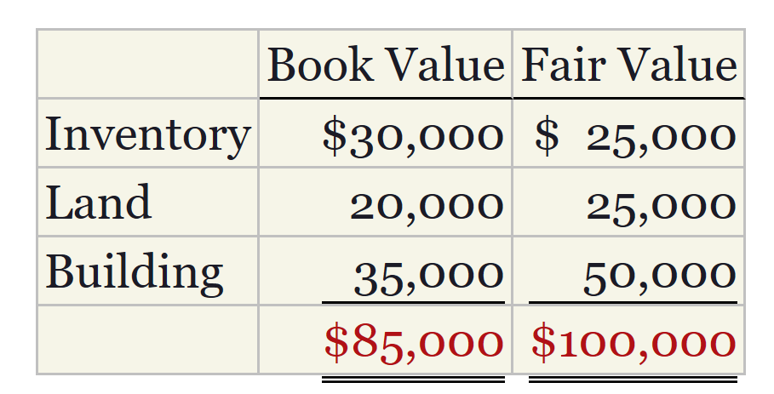
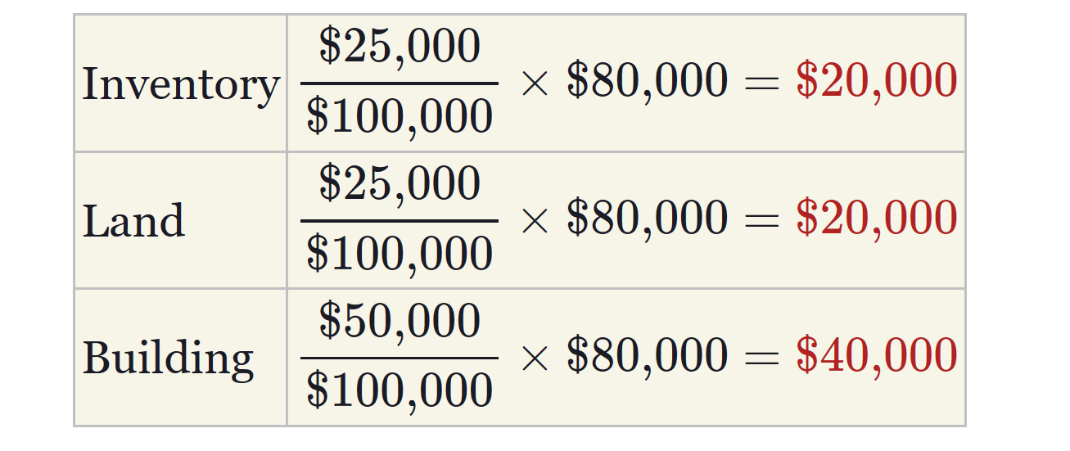
Lump-Sum Purchases
Illustrate. Norduct Homes, Inc. decides to purchase several assets of a small heating concern, Comfort Heating, for $80,000. Comfort Heating is in the process of liquidation. Its assets sold are as follows.
Norduct Homes allocates the $80,000 purchase price on the basis of the relative fair values
LO 3
Notes:
In some instances, a company may purchase a group of plant assets at a single lump sum price. The best way to allocate the purchase price of the assets to the individual items is the relative fair values of the assets acquired.

Slide 12
Lump-Sum Purchases
Illustrate. Norduct Homes, Inc. decides to purchase several assets of a small heating concern, Comfort Heating, for $80,000. Comfort Heating is in the process of liquidation. Its assets sold are as follows.
Norduct Homes allocates the $80,000 purchase price on the basis of the relative fair values
Date | Account | Debit | Credit
 | Inventory 存货 | 20,000
 | Land 无形资产——土地使用权 | 20,000
 | Building 固定资产——楼宇XX | 40,000
 | Cash 银行存款 |  | 80,000
LO 3
Notes:
In some instances, a company may purchase a group of plant assets at a single lump sum price. The best way to allocate the purchase price of the assets to the individual items is the relative fair values of the assets acquired.

Slide 13
Issuance of Shares
Illustrate. Upgrade Living Co. decides to purchase some adjacent land for expansion of its carpeting and cabinet operation. In lieu of paying cash for the land, the company issues to Deedland Company 5,000 ordinary shares (par value $10) that have a market price of $12 per share. Upgrade Living Co. records the following entry.
Date | Account | Debit | Credit
 | Land (5,000 × $12) 无形资产——土地使用权 | 60,000
 | Share Capital—Ordinary 股本——普通股 |  | 50,000
 | Share Premium—Ordinary 资本公积——股本溢价——普通股 |  | 10,000
LO 3
Notes:
When companies acquire property by issuing securities, such as ordinary shares, the par or stated value of such shares fails to properly measure the property cost. If trading of the shares is active, the market price of the shares issued is a fair indication of the cost of the property acquired. The shares are a good measure of the current cash equivalent price.
If the company cannot determine the fair value of the ordinary shares exchanged (based on a market price), it may estimate the fair value of the property. It then uses the value of the property as the basis for recording the asset and issuance of the ordinary shares.

Slide 14
Valuation of PP&E
Exchanges of Non-Monetary Assets
Ordinarily accounted for on the basis of:
the fair value of the asset given up or
the fair value of the asset received,
whichever is clearly more evident.
Companies should recognize immediately any gains or losses on the exchange when the transaction has commercial substance.
LO 3

Slide 15
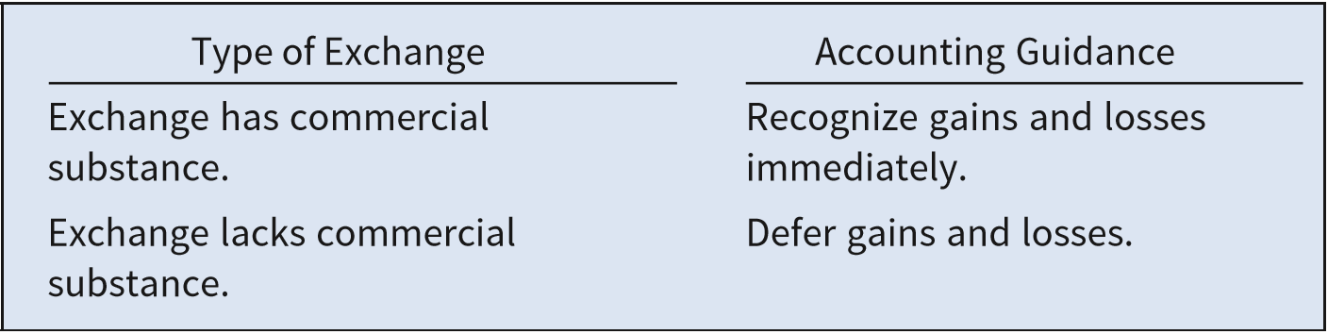
Exchanges of Non-Monetary Assets
Meaning of Commercial Substance
Exchange has commercial substance if the future cash flows change as a result of the transaction. That is, if the two parties’ economic positions change, the transaction has commercial substance.
ILLUSTRATION 10.10
Accounting for Exchanges
LO 3
Notes:
An exchange has commercial substance if the future cash flows change as a result of the transaction. That is, if the two parties’ economic positions change, the transaction has commercial substance.
For example, Andrew Co. exchanges some of its equipment for land held by Roddick Inc. It is likely that the timing and amount of the cash flows arising for the land will differ significantly from the cash flows arising from the equipment. As a result, both Andrew Co. and Roddick Inc. are in different economic positions. Therefore, the exchange has commercial substance, and the companies recognize a gain or loss on the exchange.
What if companies exchange similar assets, such as one truck for another truck? Even in an exchange of similar assets, a change in the economic position of the company can result. For example, let’s say the useful life of the truck received is significantly longer than that of the truck given up. The cash flows for the trucks can differ significantly. As a result, the transaction has commercial substance, and the company should use fair value as a basis for measuring the asset received in the exchange.
However, it is possible to exchange similar assets but not have a significant difference in cash flows. That is, the company is in the same economic position as before the exchange. In that case, the company generally defers gains and losses on the exchange.

Slide 16
Exchanges of Non-Monetary Assets
Loss Situation (Has Commercial Substance)
Companies recognize a loss if the exchange has commercial substance.
Rationale: Companies should not value assets at more than their cash equivalent price. If the loss were deferred, assets would be overstated.
LO 3

Slide 17
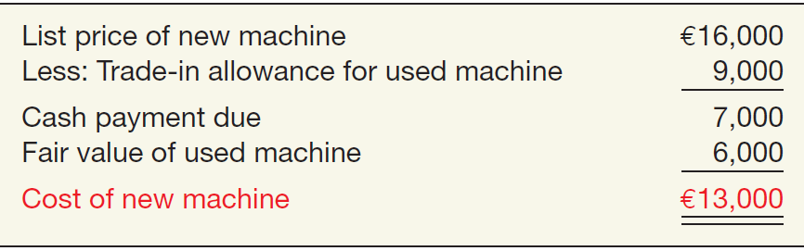
Loss Situation (Has Commercial Substance)
Illustration: Information Processing PA trades its used machine for a new model at Jerrod Business Solutions NV. The exchange has commercial substance. The used machine has a book value of €8,000 (original cost €12,000 less €4,000 accumulated depreciation) and a fair value of €6,000. The new model lists for €16,000. Jerrod gives Information Processing a trade-in allowance of €9,000 for the used machine. Information Processing computes the cost of the new asset as follows.
ILLUSTRATION 10.9
Computation of Cost of
New Machine
LO 3

Slide 18
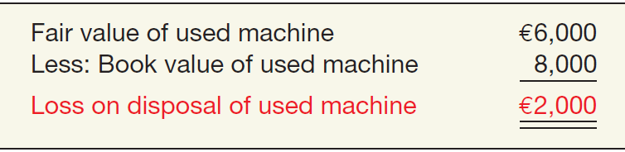
Loss Situation (Has Commercial Substance)
Illustration: Information Processing records this transaction as follows:
Equipment-New 13,000
固定资产——机器设备XX
Accumulated Depreciation—Equipment 4,000
累计折旧——机器设备XX
Loss on Disposal of Equipment 2,000
资产处置损益
Equipment-Old 12,000
固定资产——机器设备YY
Cash 7,000
银行存款
ILLUSTRATION 10.10
Computation of Loss
on Disposal of Used
Machine
Loss on Disposal
LO 3
Notes:
Loss on Disposal of Equipment 资产处置损益

Slide 19
Exchanges of Non-Monetary Assets
Gain Situation (Has Commercial Substance)
Company usually records the cost of a non-monetary asset acquired in exchange for another non-monetary asset at the fair value of the asset given up, and immediately recognizes a gain.
LO 3
Notes:
The company should use the fair value of the asset received only if it is more clearly evident than the fair value of the asset given up.

Slide 20
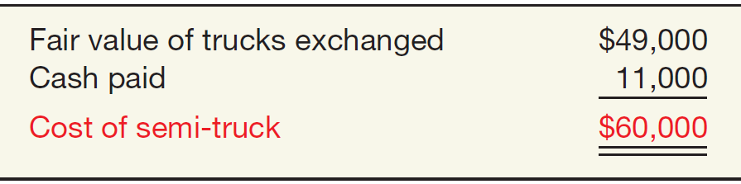
Gain Situation (Has Commercial Substance)
Illustration: Interstate Transportation Company exchanged a number of used trucks plus cash for a semi-truck. The used trucks have a combined book value of $42,000 (cost $64,000 less $22,000 accumulated depreciation). Interstate’s purchasing agent, experienced in the secondhand market, indicates that the used trucks have a fair market value of $49,000. In addition to the trucks, Interstate must pay $11,000 cash for the semi-truck. Interstate computes the cost of the semi-truck as follows.
ILLUSTRATION 10.11
Computation of Semi-Truck Cost
LO 3

Slide 21
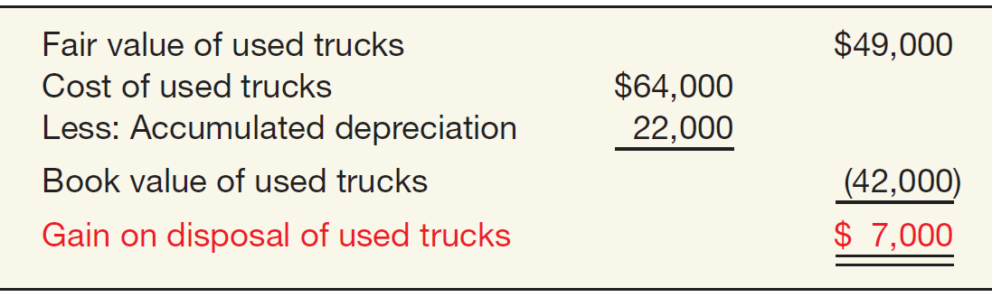
Gain Situation (Has Commercial Substance)
Illustration: Interstate records the exchange transaction as follows:
Truck (semi) 60,000
固定资产—设备—Semi Truck
Accumulated Depreciation—Trucks 22,000
累计折旧—设备—Semi Truck
Trucks (used) 64,000
固定资产—设备—Trucks
Gain on Disposal of Trucks 7,000
资产处置损失
Cash 11,000
银行存款
ILLUSTRATION 10.12
Computation of Gain on Disposal of Used Trucks
Gain on Disposal
LO 3

Slide 22
Exchanges of Non-Monetary Assets
Lacks Commercial Substance
Now assume that Interstate Transportation Company exchange lacks commercial substance.
Interstate defers the gain of $7,000 and reduces the basis of the semi-truck.
LO 3

Slide 23
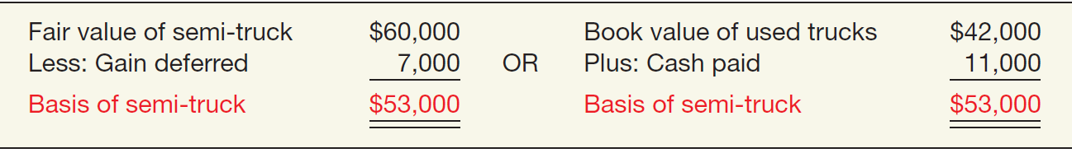
Exchanges of Non-Monetary Assets
Illustration: Interstate records the exchange transaction as follows:
Trucks (semi) 53,000
固定资产——设备——Semi Trucks
Accumulated Depreciation—Trucks 22,000
累计折旧——设备——Trucks
Trucks (used) 64,000
固定资产——设备——Trucks
Cash 银行存款 11,000
ILLUSTRATION 10.13
Basis of Semi-Truck—Fair Value vs. Book Value
LO 3
Notes:
If the exchange lacks commercial substance, the company recognizes the gain (reflected in the basis of the semi-truck) when it later sells the semi-truck, not at the time of the exchange.

Slide 24
Exchanges of Non-Monetary Assets
Summary of Gain and Loss Recognition on Exchanges of Non-Monetary Assets
ILLUSTRATION 10.16
Compute the total gain or loss on the transaction. This amount is equal to the difference between the fair value of the asset given up and the book value of the asset given up.
If the exchange has commercial substance, recognize the entire gain or loss.
If the exchange lacks commercial substance, no gain or loss is recognized.
Disclosure include
nature of the transaction(s),
method of accounting for the assets exchanged, and
gains or losses recognized on the exchanges.
LO 3

Slide 25
Valuation of PP&E
Government Grants
Government Grants are assistance received from a government in the form of transfers of resources to a company in return for past or future compliance with certain conditions relating to the operating activities of the company.
IFRS requires grants to be recognized in income (income approach) on a systematic basis that matches them with the related costs that they are intended to compensate.
Recording the grant as deferred grant revenue, which is recognized as income on a systematic basis over the useful life of the asset,
Or Deducting the grant from the carrying amount of the assets received from the grant, in which case the grant is recognized in income as a reduction of depreciation expense.
LO 3
Notes:
For example, AB InBev NV (BEL) received government grants related to fiscal incentives given by certain Brazilian states, based on the company’s operations and investments in these states. Danisco A/S (DEN) notes that it receives government grants for such items as research, development, and carbon-dioxide (CO2) allowances and investments.
In other words, a government grant is often some type of asset (such as cash; securities; property, plant, and equipment; or use of facilities) provided as a subsidy to a company.
A government grant also occurs when debt is forgiven or borrowings are provided to the company at a below-market interest rate.
IFRS requires the income approach. The general rule is that grants should be recognized in income on a systematic basis that matches them with the related costs that they are intended to compensate. [8] This is accomplished in one of two ways for an asset such as property, plant, and equipment:
Recording the grant as deferred grant revenue, which is recognized as income on a systematic basis over the useful life of the asset, orDeducting the grant from the carrying amount of the assets received from the grant, in which case the grant is recognized in income as a reduction of depreciation expense.To illustrate application of the income approach, consider the following three examples.

Slide 26
Government Grants
Example 1: Grant for Lab Equipment. Spectrum AG received a €500,000 subsidy from the government to purchase lab equipment on January 2, 2019. The lab equipment cost is €2,000,000, has a useful life of five years, and is depreciated on the straight-line basis.
IFRS allows AG to record this grant in one of two ways:
Credit Deferred Grant Revenue for the subsidy and amortize the deferred grant revenue over the five-year period.
Credit the lab equipment for the subsidy and depreciate this amount over the five-year period.
LO 3
Notes:
deferred grant revenue 递延收益
Grant revenue 其他收益
营业外收入

Slide 27
Government Grants
Example 1: Grant for Lab Equipment. If Spectrum chooses to record deferred revenue of €500,000, it amortizes this amount over the five-year period to income (€100,000 per year). The effects on the financial statements at December 31, 2019, are:
Date | Account | Debit € | Credit €
January 2, 2019 | Equipment 固定资产—实验设备 | 2,000,000
 | Cash 银行存款 |  | 2,000,000
 | Cash 银行存款 | 500,000
 | Deferred Grant Revenue 递延收益 |  | 500,000
December 31, 2019 | Depreciation Expense 折旧费用 | 400,000
 | Accumulated Depreciation累计折旧 |  | 400,000
 | Deferred Grant Revenue 递延收益 | 100,000
 | Grant Revenue 其他收益 |  | 100,000
LO 3

Slide 28
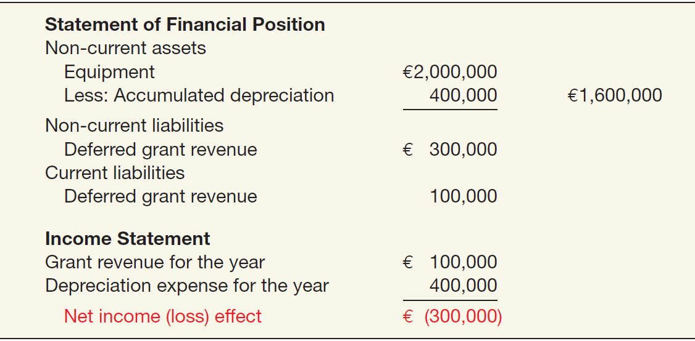
Government Grants
Example 1: Grant for Lab Equipment. If Spectrum chooses to record deferred revenue of €500,000, it amortizes this amount over the five-year period to income (€100,000 per year). The effects on the financial statements at December 31, 2019, are:
ILLUSTRATION 10.15
Government Grant
Recorded as Deferred
Revenue
LO 3

Slide 29
Government Grants
Example 1: Grant for Lab Equipment. If Spectrum chooses to reduce the cost of the lab equipment, Spectrum reports the equipment at €1,500,000 (€2,000,000 - €500,000) and depreciates this amount over the five-year period. The effects on the financial statements at December 31, 2019, are:
Date | Account | Debit € | Credit €
January 2, 2019 | Cash 银行存款 | 500,000
 | Deferred Grant Revenue 递延收益 |  | 500,000
 | Equipment 固定资产—实验设备 | 2,000,000
 | Cash 银行存款 |  | 2,000,000
 | Deferred Grant Revenue 递延收益 | 500,000
 | Equipment 固定资产—实验设备 |  | 500,000
December 31, 2019 | Depreciation Expense 折旧费用 | 300,000
 | Accumulated Depreciation 累计折旧 |  | 300,000
LO 3

Slide 30
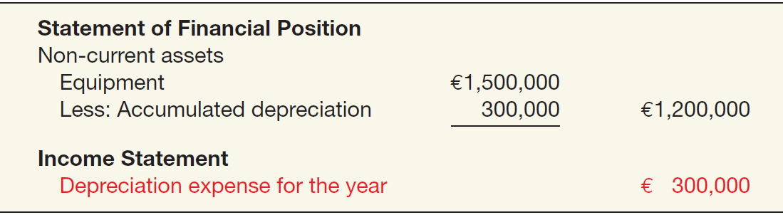
Government Grants
Example 1: Grant for Lab Equipment. If Spectrum chooses to reduce the cost of the lab equipment, Spectrum reports the equipment at €1,500,000 (€2,000,000 - €500,000) and depreciates this amount over the five-year period. The effects on the financial statements at December 31, 2019, are:
ILLUSTRATION 10.16
Government Grant Adjusted to Asset
LO 3

Slide 31
Government Grants
Example 2: Grant for Past Losses. Flyaway Airlines has incurred substantial operating losses over the last ﬁve years. The City of Plentiville does not want to lose airline service and therefore agrees to provide a cash grant of $1,000,000 to the airline to pay oﬀ its creditors so that it may continue service. Because the grant is given to pay amounts owed to creditors for past losses, Flyaway Airlines should record the income in the period it is received.
Account | Debit $ | Credit $
Cash 银行存款 1,000,000
Grant Revenue 其他收益 1,000,000
If the conditions indicate that Flyaway must satisfy some future obligations, then it is appropriate to credit Deferred Grant Revenue and amortize it over the appropriate periods in the future.
LO 3

Slide 32
Government Grants
Example 3: Grant for Borrowing Costs. Flyaway The City of Puerto Aloa is encouraging the high-tech ﬁrm TechSmart to move its plant to Puerto Aloa. The city has agreed to provide an interest-free loan of $10,000,000, with the loan payable at the end of 10 years, provided that TechSmart will employ at least 50 percent of its work force from the community of Puerto Aloa over the next 10 years. TechSmart’s incremental borrowing rate is 9 percent. The present value of the future loan payable ($10,000,000) is $4,224,100 ($10,000,000 × .42241i=9%, n=10). The entry to record the borrowing is as follows.
Cash 银行存款 4,224,100
Loan Payable 长期借款 4,224,100
LO 3

Slide 33
Government Grants
In addition, using the deferred revenue approach, the company records the grant as follows ($10,000,000 - $ 4,224,100 ).
Cash 银行存款 5,775,900
Deferred Grant Revenue 递延收益 5,775,900
Date | Account | Debit $ | Credit $
 | Cash 银行存款 | 10,000,000
 | Loan Payable 长期借款——利息调整 | 5,775,900
 | Loan Payble 长期借款——本金 |  | 10,000,000
 | Deferred Grant Revenue 递延收益 |  | 5,775,900
LO 3

Slide 34
Government Grants
 | DISCOUNT AMORTIZATION - EFFECTIVE INTEREST METHOD & DEFERRED GRANT REVENUE AMORTIZATION
Year | Actual interest payment | Interest subsidized by the GOV | Interest & principal payment by the company | Discounted cash outflow | Effective interest | Discount amortization | Carrying amount of loan
0 |  |  |  |  |  |  | 4,224,100
1 | 900,000 | 900,000 | 0 | 0 | 380,169 | 380,169 | 4,604,269
2 | 900,000 | 900,000 | 0 | 0 | 414,384 | 414,384 | 5,018,653
3 | 900,000 | 900,000 | 0 | 0 | 451,679 | 451,679 | 5,470,332
4 | 900,000 | 900,000 | 0 | 0 | 492,330 | 492,330 | 5,962,662
5 | 900,000 | 900,000 | 0 | 0 | 536,640 | 536,640 | 6,499,301
6 | 900,000 | 900,000 | 0 | 0 | 584,937 | 584,937 | 7,084,239
7 | 900,000 | 900,000 | 0 | 0 | 637,581 | 637,581 | 7,721,820
8 | 900,000 | 900,000 | 0 | 0 | 694,964 | 694,964 | 8,416,784
9 | 900,000 | 900,000 | 0 | 0 | 757,511 | 757,511 | 9,174,294
10 | 900,000 | 900,000 | 10,000,000 | 4,224,100 | 825,705 | 825,705 | 10,000,000
Total | 9,000,000 | 9,000,000 | 0 |  | 5,775,900
Note: | 380,169 = | 4,224,100 | ✕ 9% | 414,384 = | 4,604,269 | ✕ 9%
 | 900,000=10,000,000 ✕ 9% |  |  | 0.422411 | 0.42241
LO 3

Slide 35
Government Grants
TechSmart then uses the eﬀective-interest rate to determine interest expense of $ 380,169 (9% × $ 4,224,100) in the ﬁrst year. The company also decreases Deferred Grant Revenue and increases Grant Revenue for $ 380,169. As a result, the net expense related to the borrowing is zero in each year.
Date | Account | Debit $ | Credit $
First Year | Interest expense 财务费用 | 380,169
 | Loan Payable 长期借款——利息调整 |  | 380,169
 | Deferred Grant Revenue 递延收益 | 380,169
 | Grant Revenue 其他收益 |  | 380,169
LO 3

Slide 36

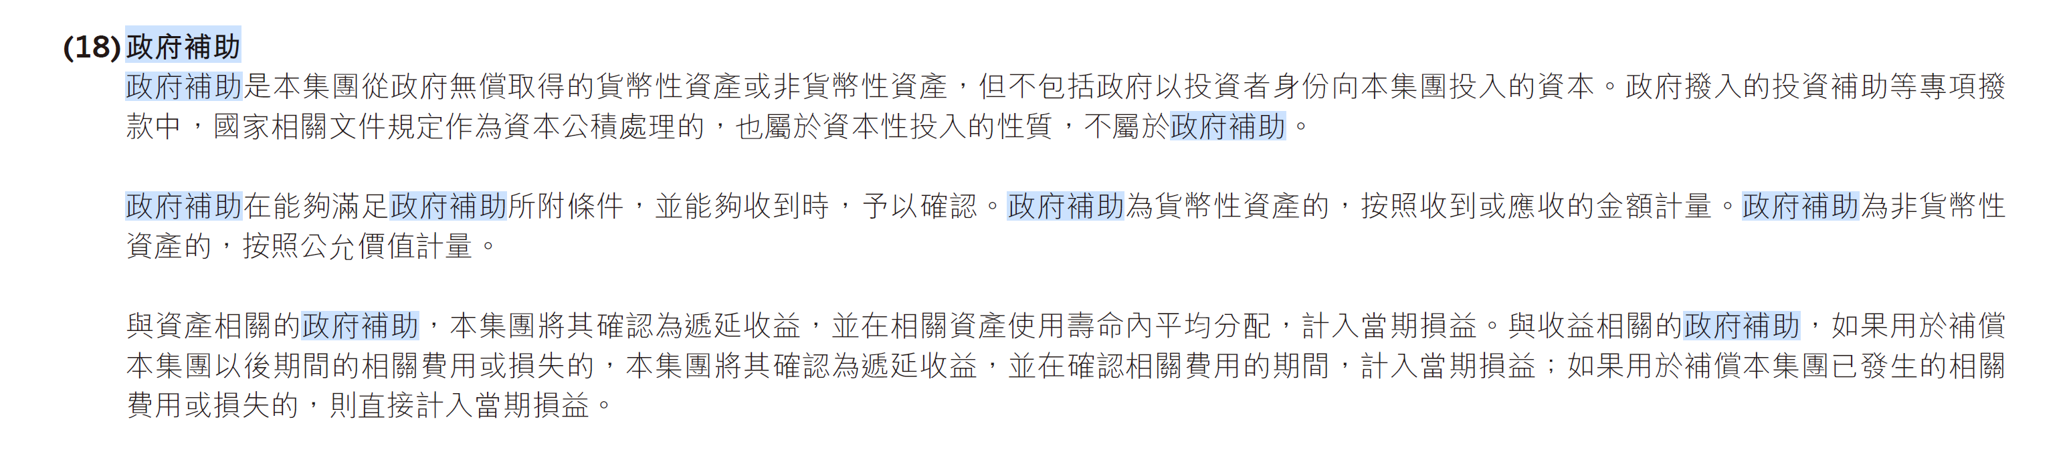
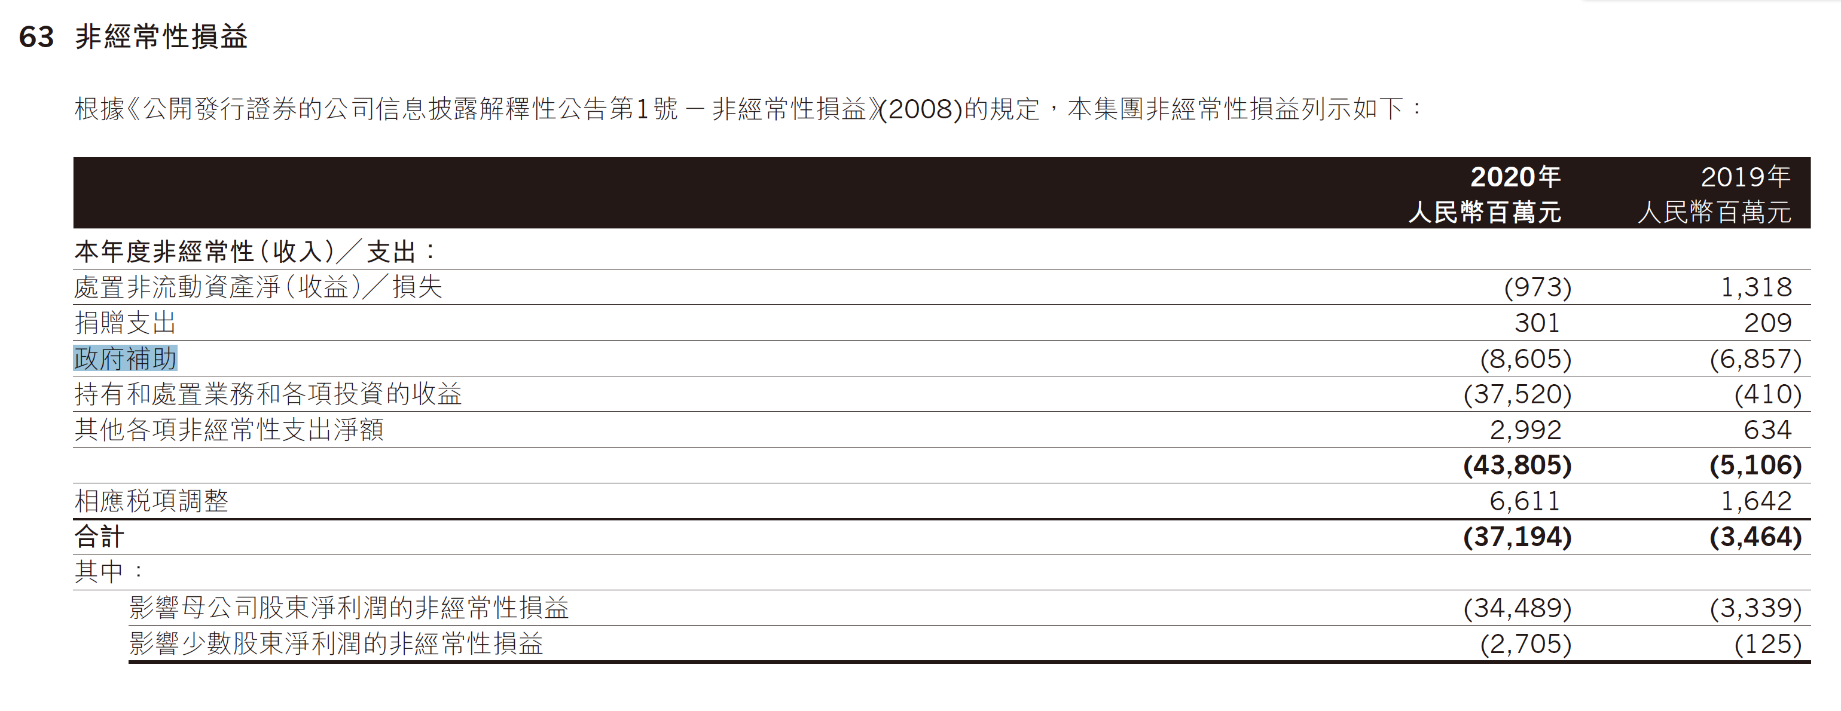

Slide 37
LEARNING OBJECTIVE 4
Describe the accounting treatment for costs subsequent to acquisition.

Slide 38
Costs Subsequent
to Acquisition
Recognize costs subsequent to acquisition as an asset when the costs can be measured reliably and it is probable that the company will obtain future economic benefits.
Evidence of future economic benefit would include increases in
useful life,
quantity of product produced, and
quality of product produced.
LO 4
Notes:
After installing plant assets and readying them for use, a company incurs additional costs that range from ordinary repairs to significant additions. The major problem is allocating these costs to the proper time periods.
In determining how costs should be allocated subsequent to acquisition, companies follow the same criteria used to determine the initial cost of property, plant, and equipment. That is, they recognize costs subsequent to acquisition as an asset when the costs can be measured reliably and it is probable that the company will obtain future economic benefits

Slide 39
Costs Subsequent to Acquisition
Major Types of Expenditures
Additions. Increase or extension of existing assets.
Improvements and Replacements. Substitution of a better or similar asset for an existing one.
Rearrangement and Reorganization. Movement of assets from one location to another.
Repairs. Expenditures that maintain assets in condition for operation.
LO 4
Notes:
Generally, companies incur four types of major expenditures relative to existing assets.

Slide 40
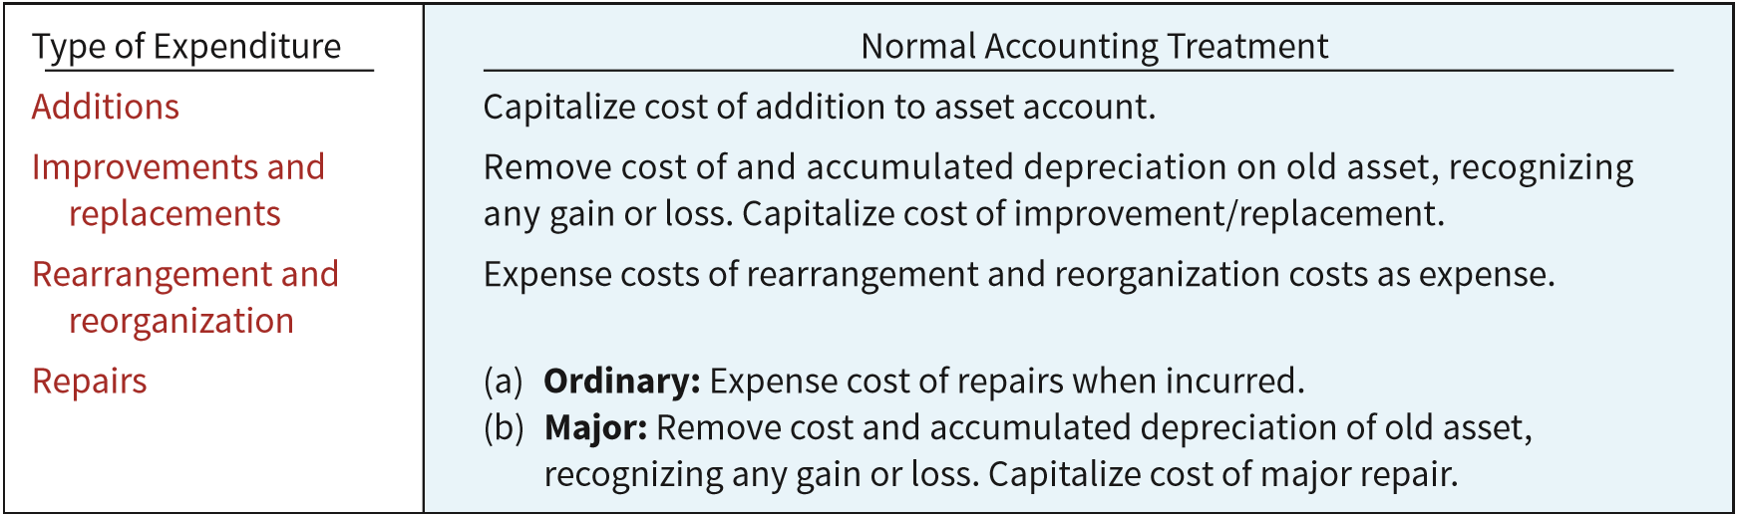
Costs Subsequent to Acquisition
ILLUSTRATION 10.19
Summary of Costs Subsequent to Acquisition of Property, Plant, and Equipment
LO 4
Notes:
By definition, companies capitalize any addition to plant assets because a new asset is created. For example, the addition of a wing to a hospital, or of an air conditioning system to an office, increases the service potential of that facility.
An improvement (betterment) is the substitution of a better asset for the one currently used (say, a concrete floor for a wooden floor). A replacement, on the other hand, is the substitution of a similar asset (a wooden floor for a wooden floor).
If the expenditure increases the future service potential of the asset, a company should capitalize it. The company should simply remove the cost of the old asset and related depreciation and recognize a loss, if any. It should then add the cost of the new substituted asset.
The question is whether the costs incurred in this rearrangement or reorganization are capitalized or expensed. IFRS indicates that the recognition of costs ceases once the asset is in the location and condition necessary to begin operations as management intended. As a result, the costs of reorganizing or rearranging existing property, plant, and equipment are not capitalized but are expensed as incurred.
A company makes ordinary repairs to maintain plant assets in operating condition. It charges ordinary repairs to an expense account in the period incurred on the basis that it is the primary period benefited.
Maintenance charges that occur regularly include replacing minor parts, lubricating and adjusting equipment, repainting, and cleaning. A company treats these as ordinary operating expenses.
If a major repair (such as an overhaul) occurs, several periods will benefit. A company should generally handle this cost as an improvement or replacement.

Slide 41
Costs Subsequent to Acquisition
Improvements and Replacements
To illustrate, Instinct Enterprises decides to replace the pipes in its plumbing system. A plumber suggests that the company use plastic tubing in place of the cast iron pipes and copper tubing. The old pipe and tubing have a book value of £15,000 (cost of £150,000 less accumulated depreciation of £135,000), and a residual value of £1,000. The plastic tubing system costs £125,000. If Instinct pays £124,000 for the new tubing after exchanging the old tubing, it makes the following entry.
Account | Debit £ | Credit £
Equipment (plumbing system) 125,000
固定资产——设备——plumbing system
Accumulated Depreciation—Equipment 135,000
累计折旧——设备——plumbing system
Loss on Disposal of Equipment 14,000
资产处置损益
Equipment (plumbing system) 150,000
固定资产——设备——plumbing system
Cash (£125,000 − £1,000) 银行存款 124,000
LO 4
Notes:
By definition, companies capitalize any addition to plant assets because a new asset is created.
Many times, improvements and replacements result from a general policy to modernize or rehabilitate an older building or piece of equipment.
The problem is differentiating these types of expenditures from normal repairs. Does the expenditure increase the future service potential of the asset? Or does it merely maintain the existing level of service? Frequently, the answer is not clear-cut. Good judgment is required to correctly classify these expenditures.If the expenditure increases the future service potential of the asset, a company should capitalize it. The company should simply remove the cost of the old asset and related depreciation and recognize a loss, if any. It should then add the cost of the new substituted asset.

Slide 42

单选题
1分
Quick Check #6
Expenditures that increase the future service potential and are a substitution of a better asset for the original asset are accounted for
此题未设置答案，请点击右侧设置按钮
A
as a replacement of a similar asset and expensed as incurred.
B
as a rearrangement of assets and is debited as an expense.
C
by adding the cost of the new asset and removing the cost of the old asset and related depreciation, and recognize a loss, if any.
D
by debiting Accumulated Depreciation for the cost of the new asset.
Submit

Slide 43
单选题
1分
In accounting for plant assets, which of the following outlays made subsequent to acquisition should be fully expensed in the period the expenditure is made?
此题未设置答案，请点击右侧设置按钮
A
Expenditure made to increase the efficiency or effectiveness of an existing asset
B
Expenditure made to extend the useful life of an existing asset beyond the time frame originally anticipated
C
Expenditure made to maintain an existing asset so that it can function in the manner intended
D
Expenditure made to add new asset services
Submit
Notes:
For example, assume the Shipaway Company has just purchased a new ship for $200 million. The useful life of the ship is 20 years, but every four years it must be dry-docked and a major overhaul done. It is estimated that the overhaul will cost $4 million. The $4 million should be accounted for as a separate component of the cost of the ship (using component depreciation) and depreciated over four years.

Slide 44
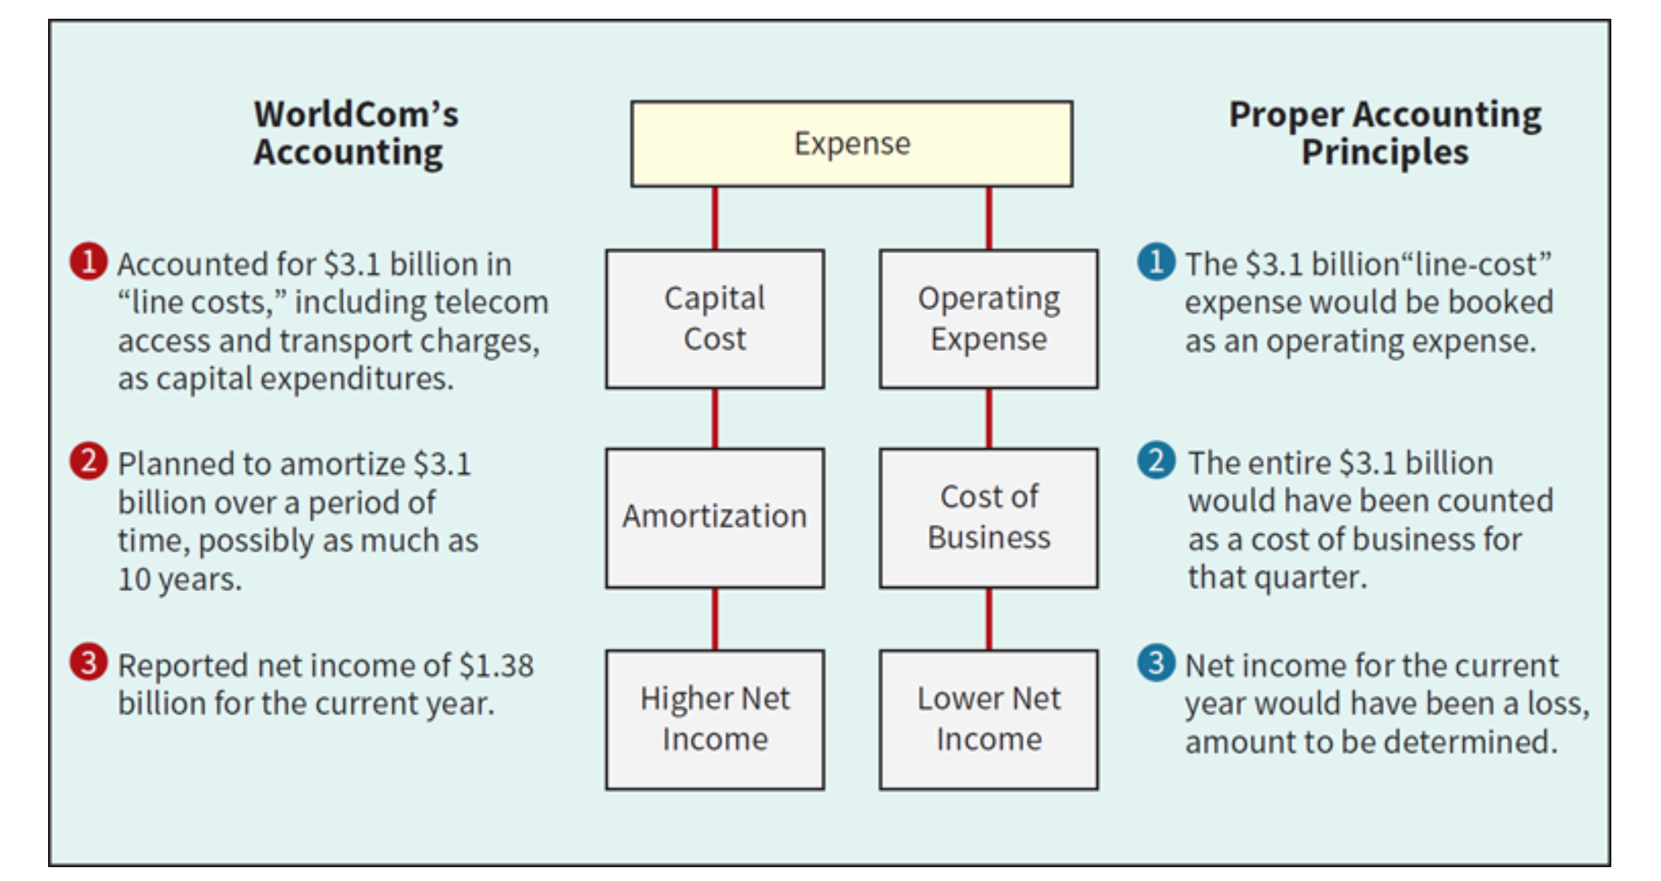
WorldCom Inc.
Inside WorldCom’s Unearthing of a Vast Accounting Scandal
Notes:
The telecom giant’s newly installed chief executive had asked for a financial review, and the auditor was spot-checking records of capital expenditures. She found the company was using an unorthodox technique to account for one of its biggest expenses: charges paid to local telephone networks to complete long-distance calls.
nstead of recording these charges as operating expenses, WorldCom recorded a significant portion as capital expenditures.

Slide 45
LEARNING OBJECTIVE 5
Describe the accounting treatment for the disposal of property, plant, and equipment.

Slide 46
Disposition of Property, Plant, and Equipment
A company may retire plant assets voluntarily or dispose of them by
Sale,
Exchange,
Involuntary conversion, or
Abandonment.
Depreciation must be taken up to the date of disposition.
LO 5
Notes:
Generally, the book value of the specific plant asset does not equal its disposal value. As a result, a gain or loss develops. The reason: Depreciation is an estimate of cost allocation and not a process of valuation. The gain or loss is really a correction of net income for the years during which Nokia used the fixed asset.

Slide 47
Disposition of PP&E
Sale of Plant Assets
Illustration: Barret Group recorded depreciation on a machine costing €18,000 for nine years at the rate of €1,200 per year. If it sells the machine in the middle of the tenth year for €7,000, Barret records depreciation to the date of sale as:
Account | Debit | Credit
Depreciation Expense (€1,200 x ½) 600
制造费用——折旧费用
Accumulated Depreciation—Machinery 600
累计折旧——机器设备
LO 5
Notes:
Companies record depreciation for the period of time between the date of the last depreciation entry and the date of sale.

Slide 48
Disposition of PP&E
Illustration: Barret Group recorded depreciation on a machine costing €18,000 for nine years at the rate of €1,200 per year. If it sells the machine in the middle of the tenth year for €7,000, Barret records depreciation to the date of sale. Record the entry to record the sale of the asset:
Account | Debit | Credit
Cash 银行存款 7,000
Accumulated Depreciation—Machinery 11,400
累计折旧——机器设备
Machinery 18,000
固定资产——机器设备——XXX
Gain on Disposal of Machinery 400
资产处置损益
LO 5
Notes:
The book value of the machinery at the time of the sale is €6,600 (€18,000 − €11,400). Because the machinery sold for €7,000, the amount of the gain on the sale is €400 (€7,000 − €6,600).
Gain on Disposal of Machinery 资产处置收益

Slide 49
Disposition of PP&E
Involuntary Conversion
Sometimes an asset’s service is terminated through some type of involuntary conversion such as fire, flood, theft, or condemnation.
Companies report the difference between the amount recovered (e.g., from a condemnation award or insurance recovery), if any, and the asset’s book value as a gain or loss.
They treat these gains or losses like any other type of disposition.
LO 5
Notes:
营业外支出-非流动资产报废
营业外支出-非常损失

Slide 50
Disposition of PP&E
Illustration: Camel Transport Corp. had a manufacturing plant located on company property that stood directly in the path of a tornado. As a result of the tornado, which occurred on May 16, 2022, the plant was completely destroyed. Camel was eventually able to reach a settlement with its insurance company for the full fair value of the plant. The settlement was reached on March 18, 2023. At the time of the tornado, the building had a carrying value of $3,500,000 (original cost of $6,000,000 less accumulated depreciation of $2,500,000). The amount of the settlement with the insurance company was $8,000,000. Camel made the following entries.
Date | Account | Debit | Credit
May 16，2022 | Loss from Tornado 营业外支出——非常损失 | 3,500,000
 | Accumulated Depreciation ─ Buildings. 累计折旧——楼宇——XXX | 2,500,000
 | Buildings 固定资产——楼宇——XXX |  | 6,000,000
Mar. 18，2023 | Cash 银行存款 | 8,000,000
 | Gain from Insurance Settlement 营业外收入 |  | 8,000,000
LO 5
Notes:
First, the loss associated with the involuntary conversion is recorded. Then, usually at a later date once the amount of the recovery has been established, the company will record a gain or revenue from the insurance proceeds or other recovery. The rationale for separating the two events is that, in most cases, both the potential and the amount of the recovery are not known at the time of the loss.
营业外收入和营业外支出

Slide 51
单选题
1分
Quick Check #7
Timber Ridge Company sold equipment with a cost of $75,000 and accumulated depreciation of $40,000 for $37,000. The journal entry to record this transaction will include a
此题未设置答案，请点击右侧设置按钮
A
credit to the Equipment account for $35,000.
B
credit to a gain account for $38,000.
C
debit to a loss account for $2,000.
D
debit to Accumulated Depreciation – Equipment for $40,000.
Submit

Slide 52


感谢您的参与！
THE HITSZ
SCHOOL OF ECONOMICS
AND MANAGEMENT

